Slide 1

Enrolment Solutions

Slide 2

iDev Solutions
Integrated Development Solutions provides innovative out of the box technological support and services that is reliable and cost-effective for small or large companies.
Our software development team operates with highly skilled, enterprising and multidisciplinary professionals from various spheres of expertise.
The company is now leveraging its technical strengths by offering a multitude of products and solutions for companies that require mission critical end-to-end business solutions.
“…developing CUSTOMIZED solutions for you!”

Slide 3
iDev Solutions
Value System
The company strives to achieve its mission through a set of core values:
Integrity
Team Spirit
Commitment to Quality and Efficiency
Healthy and Sincere Working Environment
“…developing CUSTOMIZED solutions for you!”

Slide 4

introduction
The University Management System (UMS) is a comprehensive innovative system for managing educational office activities of University.
Developed by iDev Solutions to support officers in educational management and administration so to help educational institutions to improve their operational efficiency.
Modules in UMS are fully integrated.
An unlimited number of users can be defined within UMS.
UMS is a multi-divisional, multi-departmental and cost-center based suite of applications, which will practically cover the entire area of operations of the University.
The UMS is built using Microsoft .NET technology, driven at the back-end by using Microsoft SQL Server, which gives the application more power in security, scalability and maintainability.

Slide 5
Product Highlights
Manage multiple colleges comprising of multiple departments
Period-wise course catalogue permits to maintain different catalogue
Streamlined registration and admission activities
Organized school management involved in scheduling program, course and syllabus details
Define multiple fee policies for different year levels.
Supports sponsors and installments in fee management

Slide 6
Core Functionalities
University Management
Define and manage various programs and courses offered by the institutions
Supports by semester system
Maintain different schedules for programs/courses being conducted at various colleges

Slide 7

Server Hardware Requirements
Intel Core 2 Duo or any other compatible processor
1 GB RAM or higher
Minimum of 40 GB HDD space

Slide 8

Server Software Requirements
Microsoft Windows 2003 Small Business Server or higher
RDBMS (Microsoft SQL Server 2005 or higher)

Slide 9
Client Hardware Requirements
Intel Pentium IV 300 MHz or higher/any other compatible processor
256MB RAM or higher
Display resolution 1024x768 pixels, recommended
Minimum 2GB HDD space

Slide 10
Client Software Requirements
Microsoft Windows XP
Internet Explorer 5.0 or higher
Macromedia flash player

Slide 11
Ums modules
University Management System

Slide 12
UMS Modules
Academic Components
Room Management & Subject Offering
ID Acquisition
Business and Finance Components
Cashiering Module
School Fee Module
Administrative Components
Employee Information System
Transaction Log
Teacher Loading
Academic Transaction
Collection Reports

Slide 13
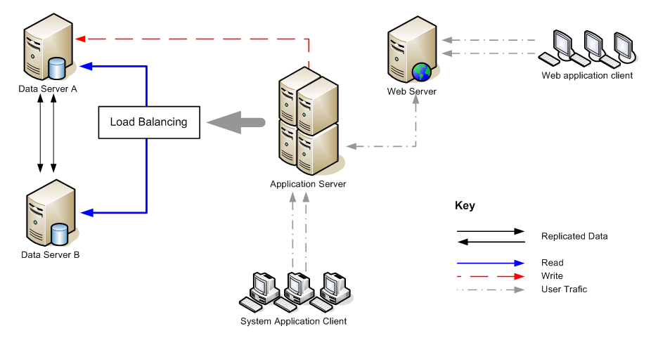
Typical UMS Setup

Slide 14
Ums SCREEN SHOTS
University Management Solution

Slide 15
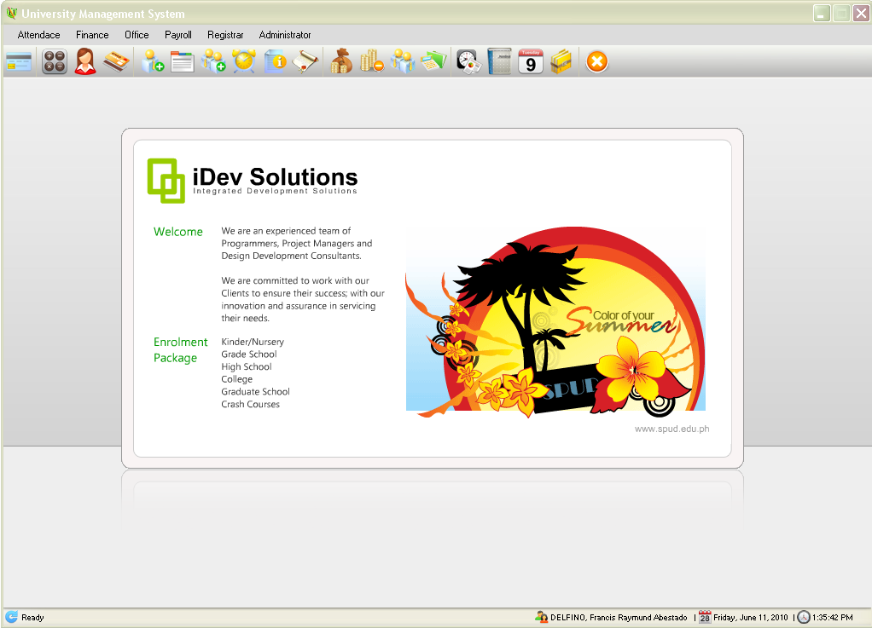
Main Window
This screen shows the main window of the UMS application.

Slide 16
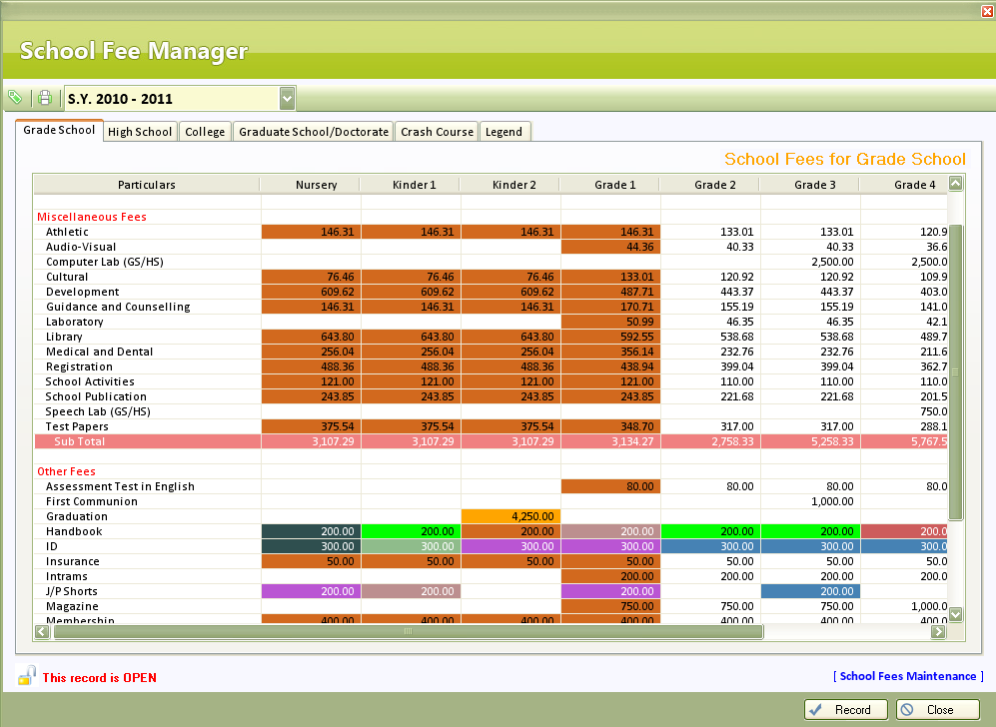
School Fee Manager
Tuition fees and other school fees are managed here.

Slide 17
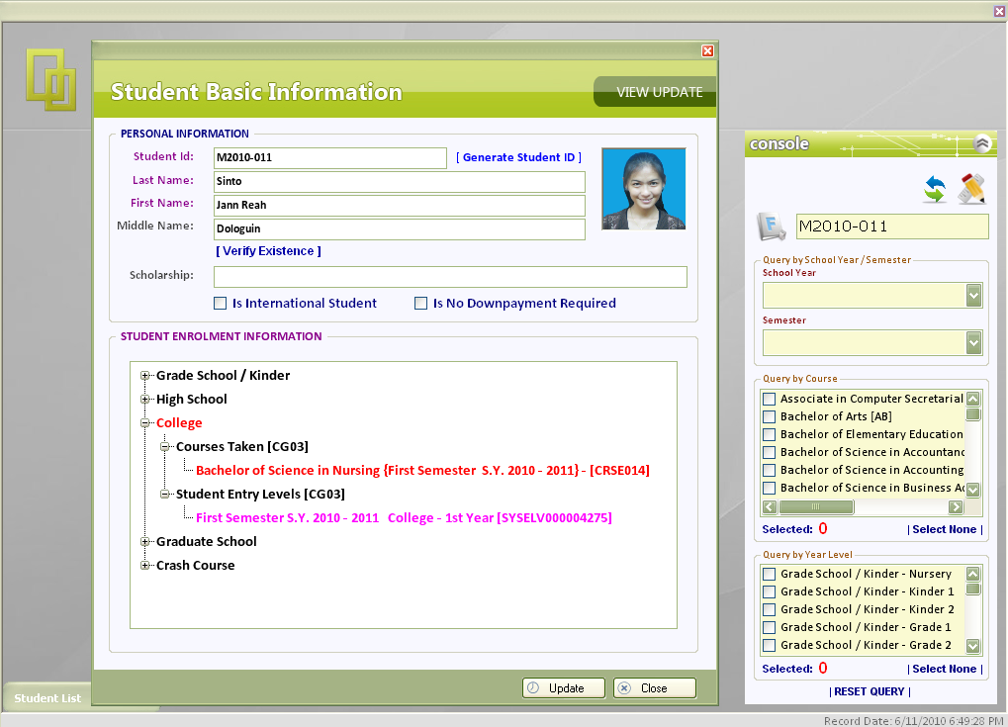
Student Manager
Search Students using various Search Criteria
View Student Enrolment History
The student manager module handles student registration process along with student basic information, and courses enrolled.

Slide 18
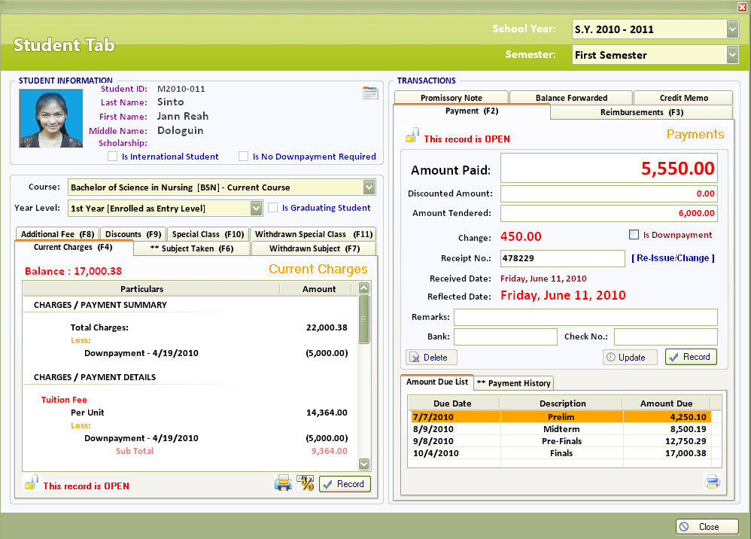
Cashiering Manager
Payment acceptance with automatic generation of Receipt No
Itemized and accurate summaries of payments and charges
System computed amount due per exam
Allows you to perform cashiering functions on a specific student which will be printed in details in the student enrolment record and generates statement of accounts and clearances based on major exam schedules defined by the registrar.

Slide 19
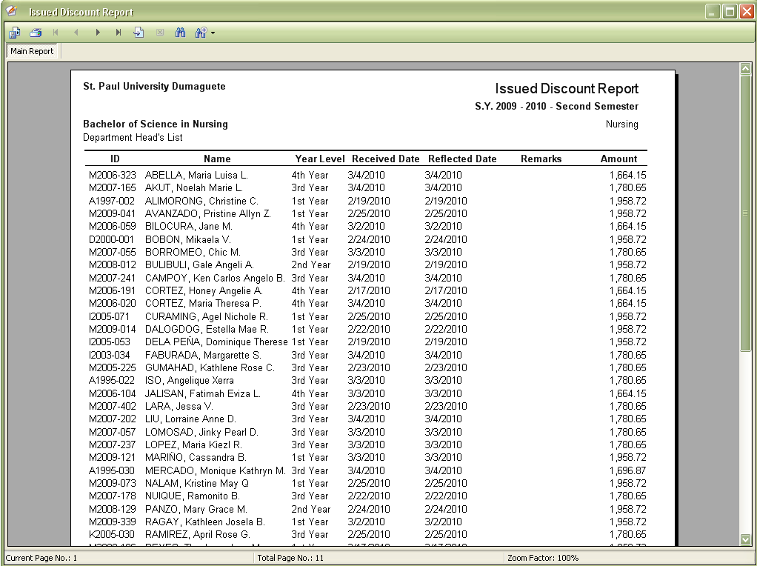
Cashiering Manager Reports
Issued Discount Report – can be generated by course and by scholarship on which the discount is being based-upon.

Slide 20
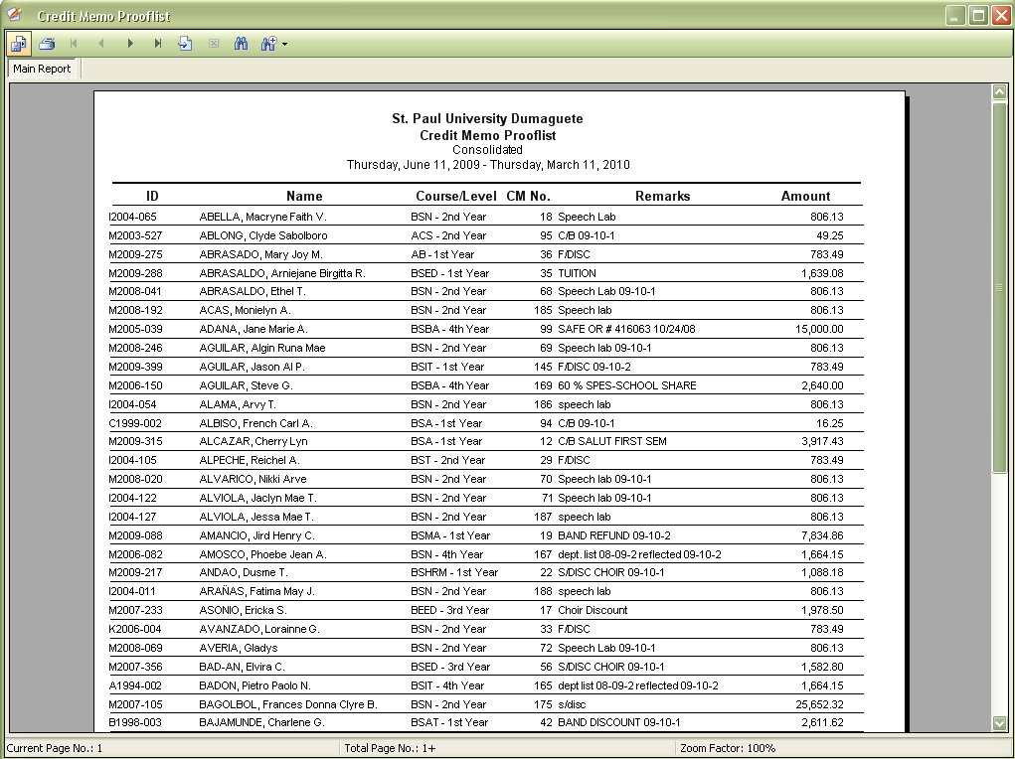
Cashiering Manager Reports
Credit Memo Prooflist – can be generated by selecting a range of dates.

Slide 21
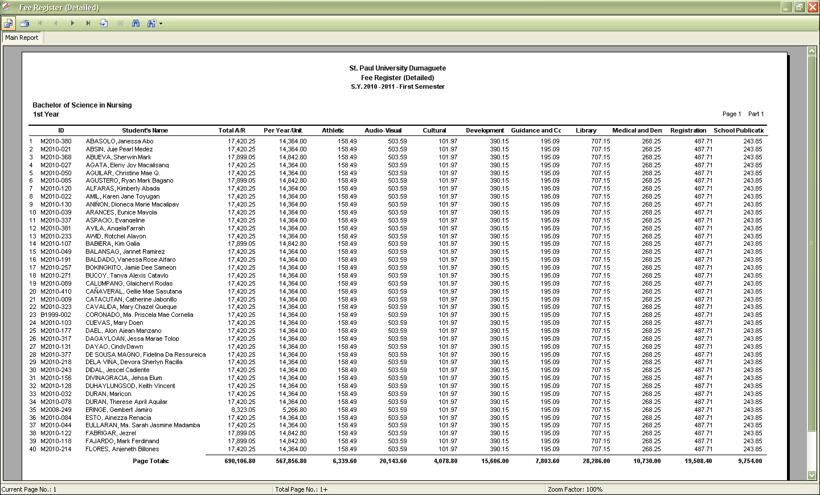
Cashiering Manager Reports
Fees Register (Detailed) – a report that will display an itemized school fee of enrolled students for a certain school year or semester which is then summarized per course and per year level and can be used for auditing purposes.

Slide 22
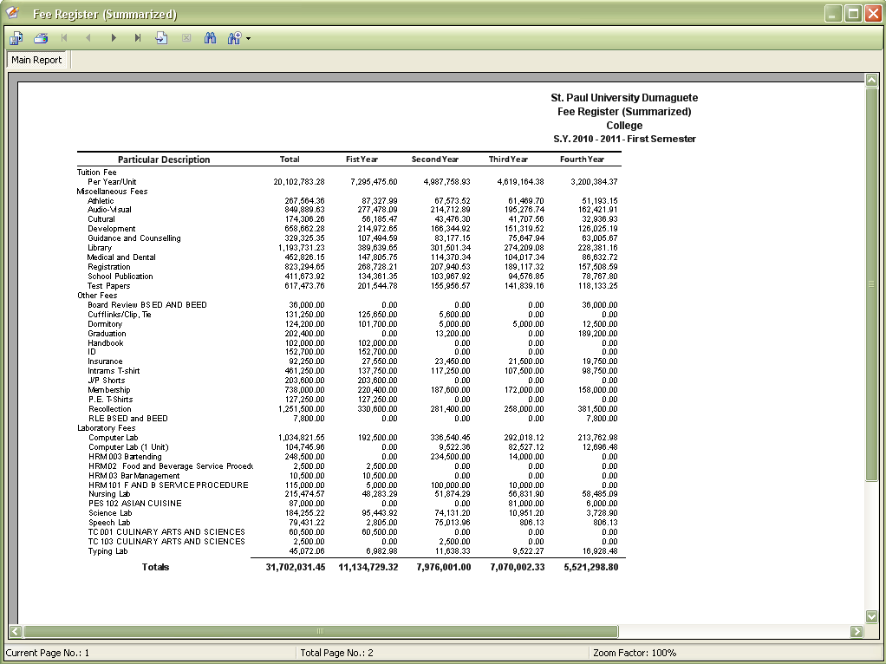
Cashiering Manager Reports
Fees Register (Summarized) – a report that will display a summarized school fee per course group (Grade School, High School, College, Graduate School, Crash Course) on a certain school year or and can be used for auditing purposes.

Slide 23
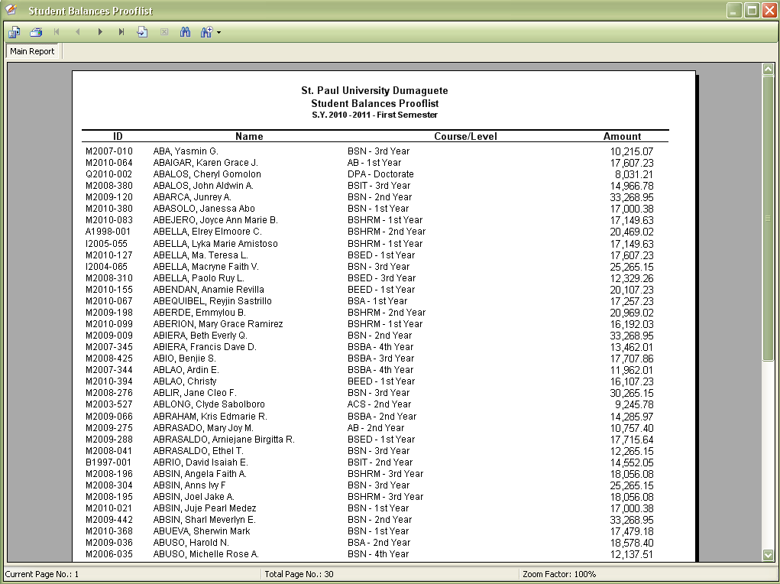
Cashiering Manager Reports
Student Balances Prooflist – an accurate report that will display the student with outstanding balances on a certain school year or semester for collection and accounting purposes.

Slide 24
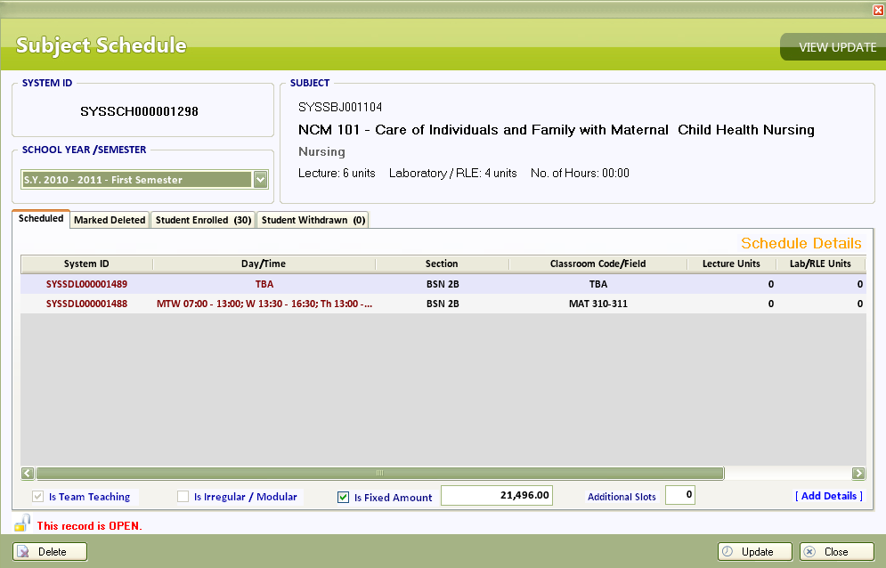
Subject Scheduling
Can handle schedules that are taught by two or more instructors (Team Teaching)
This screen shows scheduling of subjects can be customized to fit almost all types of procedures a university may used to schedule a particular subject.

Slide 25
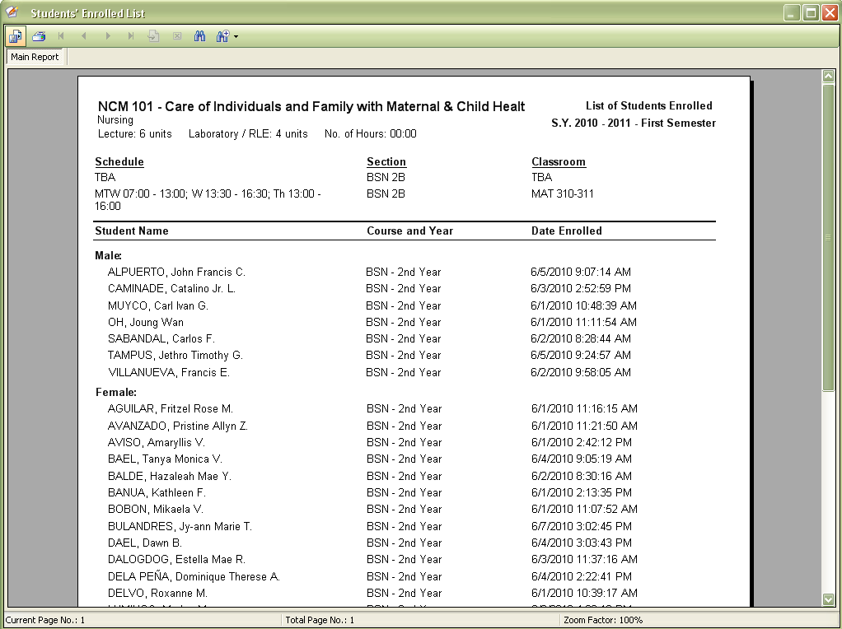
Subject Scheduling Report
List of Students Enrolled – A report that can be given to an assigned instructor to be used as the instructor’s class master list.

Slide 26
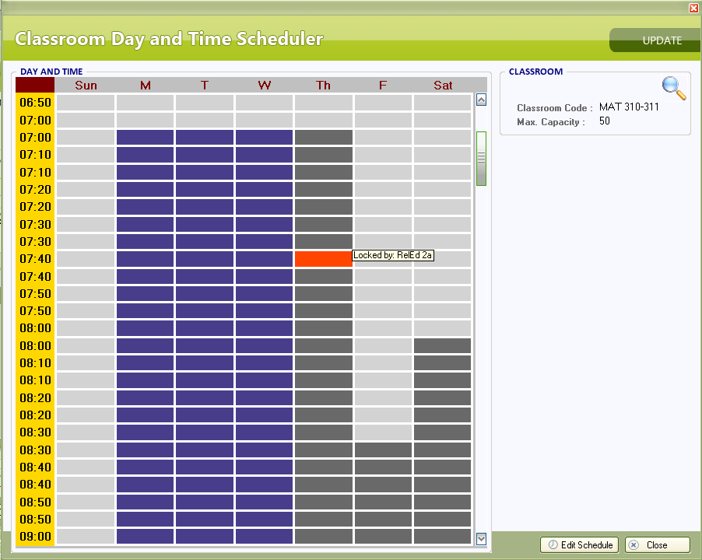
Day and Time Scheduler
Lock a time slot that has a schedule already assigned to prevent conflicts of student and teacher class schedules.
This screen shows creating of schedules made easy.

Slide 27
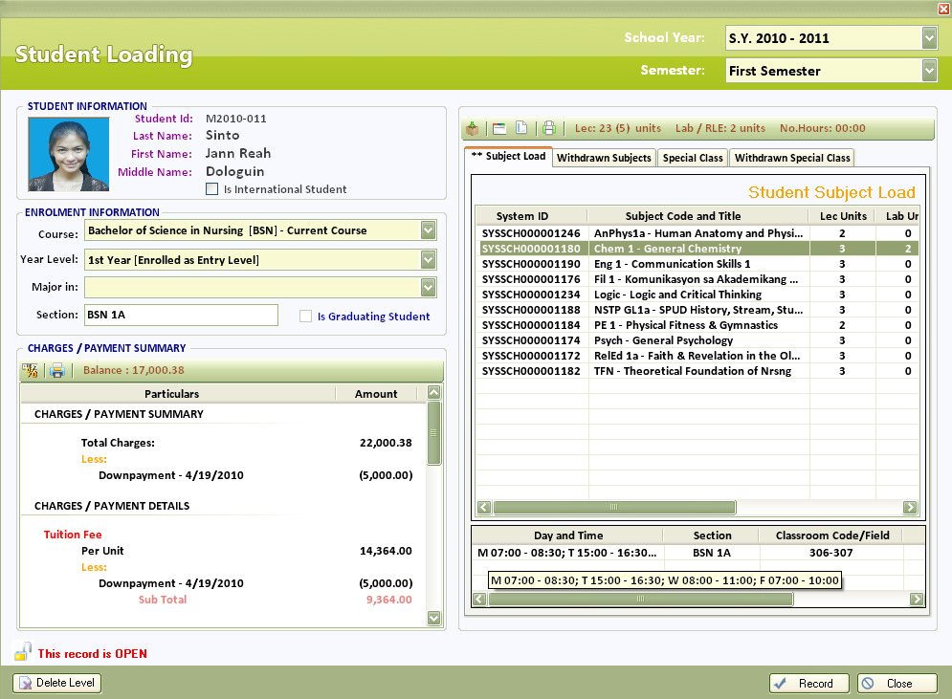
Student Loading
Student Information
Student Subject Load
Current Charges Information
This screen allows you to manage subjects taken by the student with a comprehensive display of the student’s payments and charges.

Slide 28
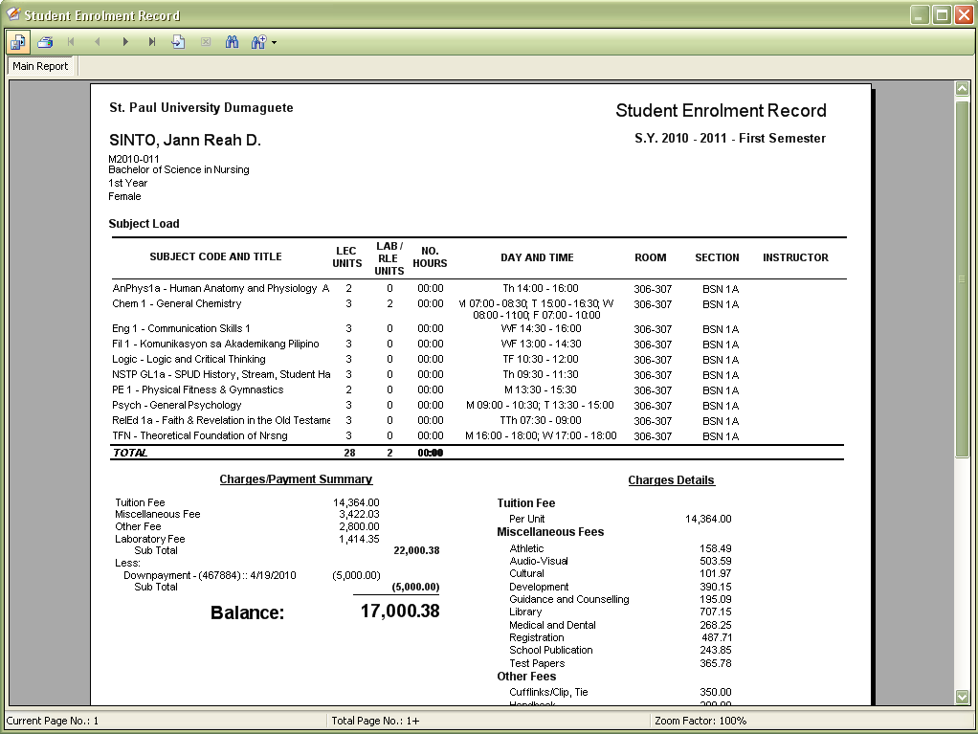
Student Loading Report
Student Enrolment Record – a thorough report that can be given to the student after subject loading. This contains the subjects and schedules taken by the student, charges/payment summary ,and the details of the charges.

Slide 29
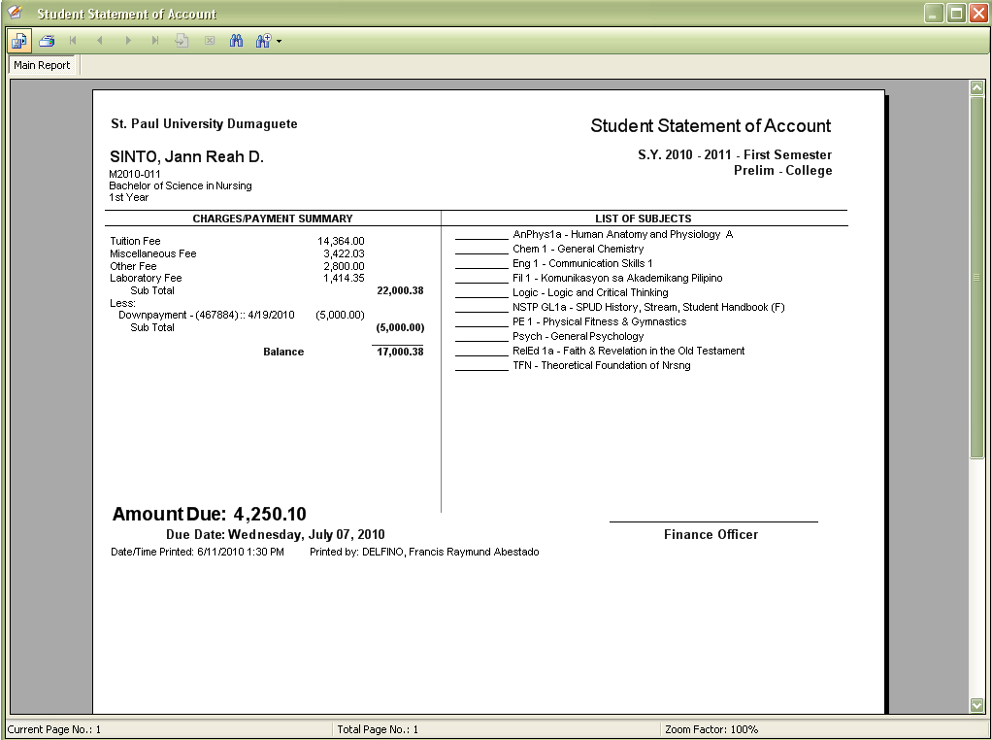
Student Loading Report
Student Statement of Account – a fast and easy to generate report that can be done on every major exam schedule to facilitate collections and can be used also as an exam permit.

Slide 30
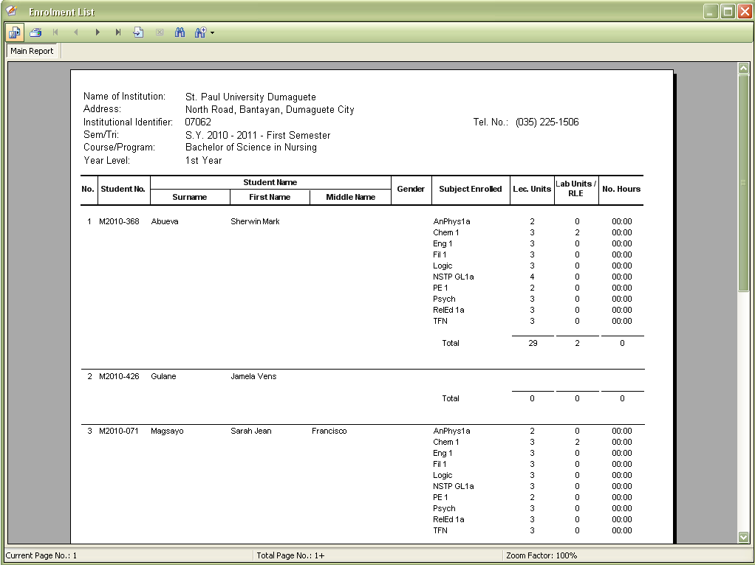
Student Loading Report
Student Enrolment List– a detail that will be used by the Registrar to swiftly comply CHED required school report.

Slide 31
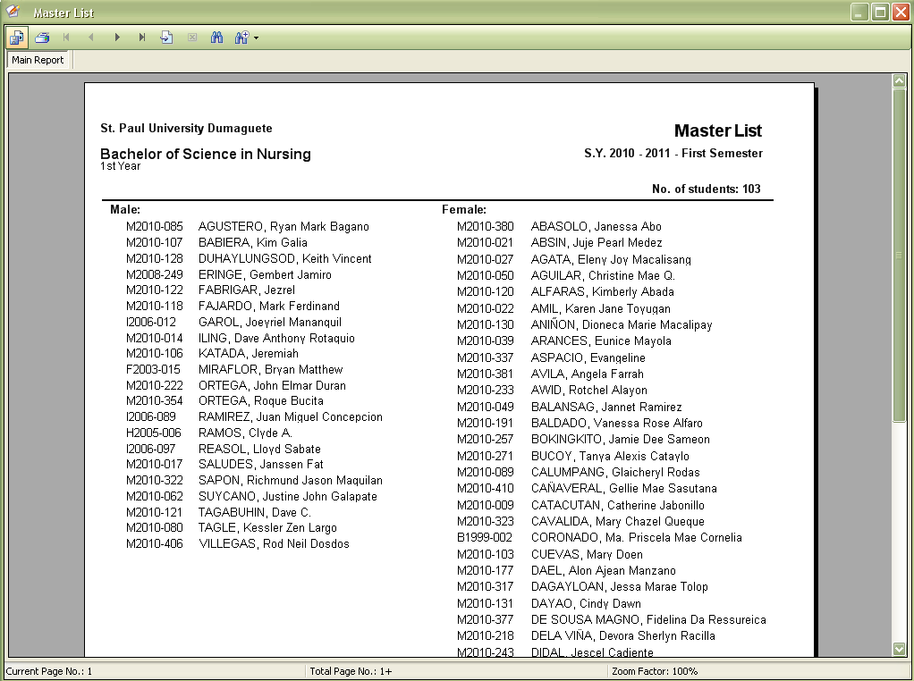
Student Loading Report
Master List– a Registrar required list of all students enrolled categorized by course and year level per school year or semester.

Slide 32
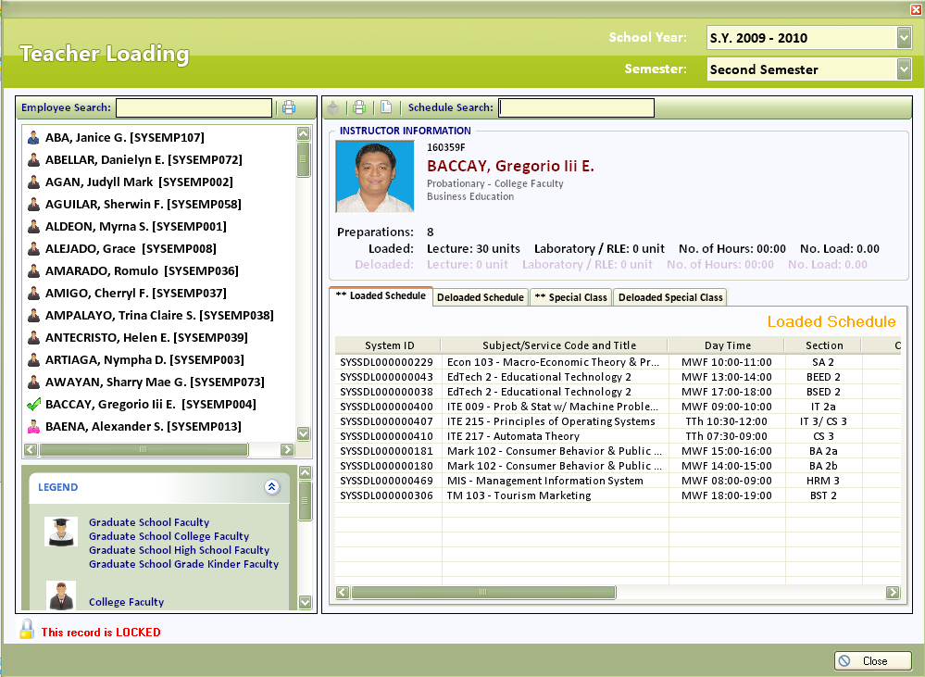
Teacher Loading
List of all employees with recognizable icons based on employment types
List of subjects loaded to a certain instructor
This modules enables user to add, update, or delete teacher subject loading.

Slide 33
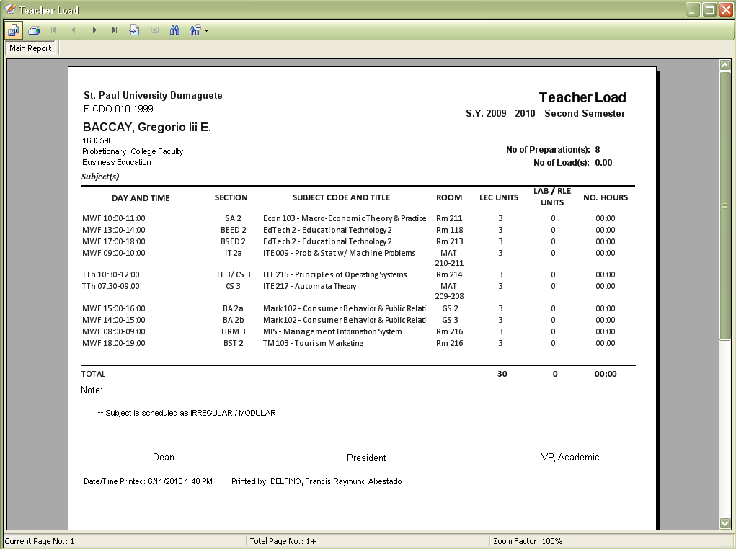
Teacher Loading Report
List of all employees with recognizable icons based on employment types
List of subjects loaded to a certain instructor
Teacher Load – a report that can be given to the teacher and a copy to the administrator which contains the teacher load on a specific school year or semester.

Slide 34
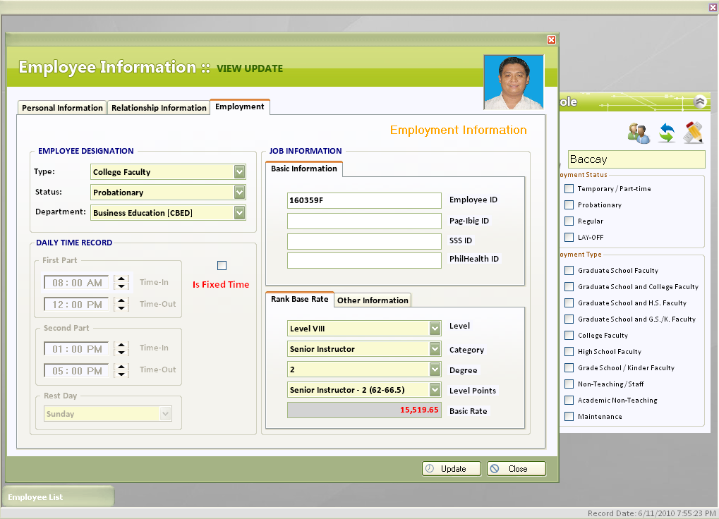
Employee Manager
Search Employees using various Search Criteria
Employment Information
This module enables the user to add or update employee details.

Slide 35
Security
System wide security to address privacy & security compliance with SQL Server.
Achieve a more secure deployment. SQL Server 2005 provides rich security features to protect data and network resources.
User password controlled and administrator controlled modular access.

Slide 36
UMS is the right choice for you
Here is why:
Proven to be stable
FREE maintenance and updates for 3 years
A Multi-tier Architecture System
It's WINDOWS based application
Notes:
s

Slide 37
Client Support
Onsite initial staff training and installation support.
Product version updates provided on as needed basis.
Support and maintenance services provided on demand.

Slide 38
Conclusion
UMS is a completely secure, confidential, interactive management system for your school. Composed of over 8 modules integrated to automate the flow of information and get your tasks done with just a few clicks of the mouse and developed using the most popular windows-based technologies. It is easy to setup and deploy!

Slide 39
Contact Us
Office Address
Contact Person
AGTI Printing Press Bldg
L. Rovira Rd., Interior
Bantayan, Dumaguete City 6200
Negros Oriental
Philippines
(035) 225-2501
look for Mrs. Erlinda T. Agan
Judyll Mark T. Agan, MIT
Solution Developer/Proprietor
Email : judyll.agan@gmail.com
Yahoo ID : judyll_agan
Skype : judyllagan
Mobile : 0915.405.5748
Home : (035) 422.3893
Francis Raymund Delfino
Junior Programmer
Email : francisdelfino@gmail.com
Yahoo ID : ansing_19
Skype : francis_delfino
Mobile : 0922.381.3397
Beaumont Jo, MIT
Web developer
Email : beumont_jo@yahoo.com
Yahoo ID : beaumont_jo
Mobile : 0919.731.5325

Slide 40
Thank you for your time…
for onsite demonstration feel free to contact us
“…developing CUSTOMIZED solutions for you!”

